Slide 1
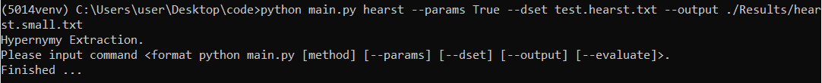
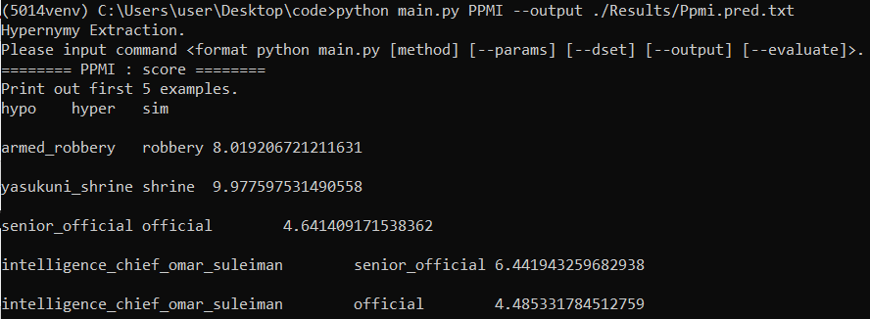
Results
* See hypernymy extraction results under ./Results folder in code.zip
Manual Hearst Patterns
Pattern-based Models --PPMI

Slide 2
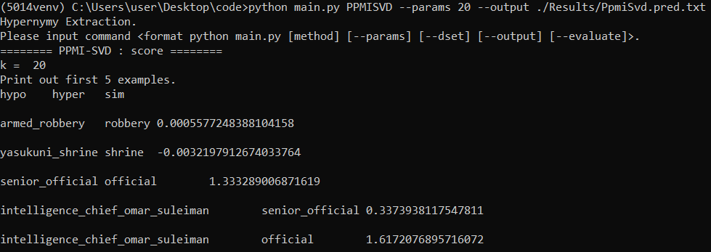
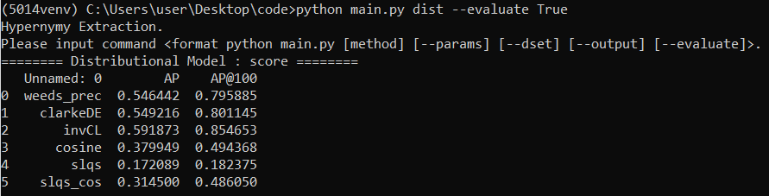
Pattern-based Models --PPMI+SVD (rank=20)
Distributional Models

Slide 3
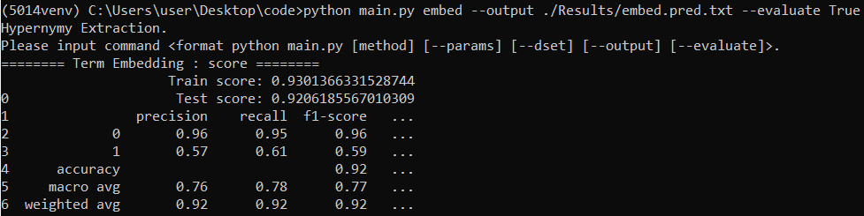
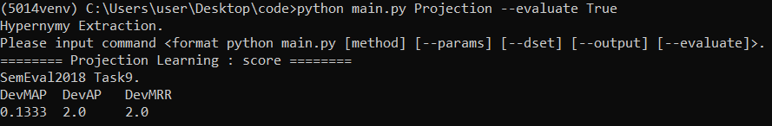
Term Embeddings
Projection Learning

Slide 4
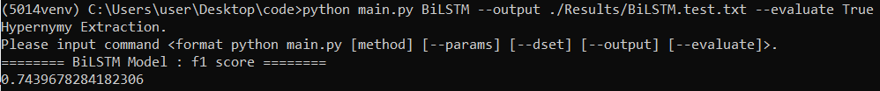
Bi - LSTM Model

